Slide 1
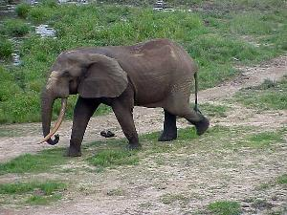
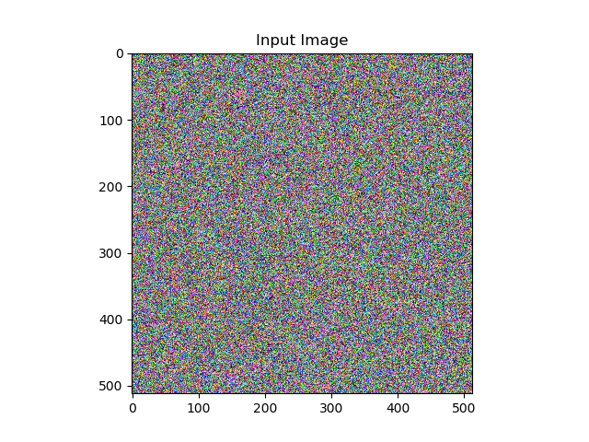
VGG19
Convolution output target
VGG19
Convolution output prediction

Slide 2

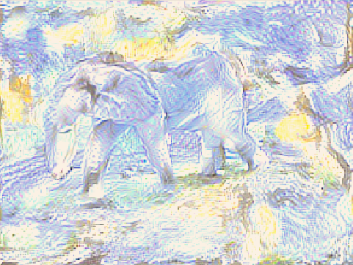
+
=

Slide 3
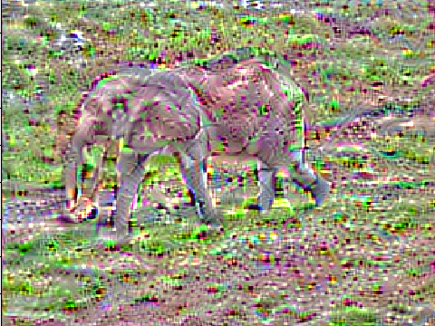

Slide 4
F
F
F
➔
*
=
F
H
H·W
W

Slide 5
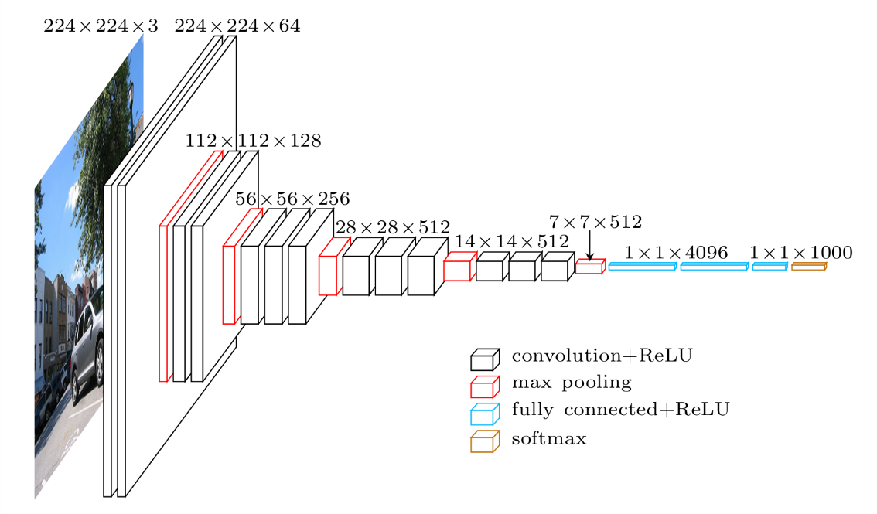
MSE
LOSS
+
W1 | W2 | W3 | W4 | W5
G MSE
G MSE
G MSE
G MSE
G MSE

